Slide 1
Laptop Price Prediction
ML Case Study, Insights and Recommendations
ML Case Study, Insights and Recommendations

Slide 2
Business Overview
ML Case Study, Insights and Recommendations
SmartTech Co. has partnered with our data science team to develop a robust machine learning model that predicts laptop prices accurately.
As the market for laptops continues to expand with a myriad of brands and specifications, having a precise pricing model becomes crucial for both consumers and manufacturers.
With this in mind, we have worked on a ML project to come up with a model that can accurately predict prices of laptops based on the specifications entered by the user / client.

Slide 3
Objectives
Accurate Pricing: Develop a model that can accurately predict laptop prices based on various features, helping our clients stay competitive in the market.
Market Positioning: Understand how different features contribute to pricing, enabling SmartTech Co. to strategically position its laptops in the market.
Brand Influence: Assess the impact of brand reputation on pricing, providing insights into brand perception and market demand.

Slide 4
Insights - Summary
Brand of the Laptop: Certain brands markedly demand a premium, while several others are reasonably priced.
Type of Laptop: The type of laptop (Ultrabook, Notebook, etc) influence a difference in price – certain types influence an increase in price.
Touchscreen & IPS Display: Brands that have Touchscreens and/or IPS displays are priced at a premium and are generally lesser in supply in the market
CPU Brand (Processor): High-end processors demand a premium while low-end processors influence a price decrement
GPU Brand: GPU brand influences a difference in price
RAM: The higher the RAM, the more the price point of the laptop
PPI (Pixels per Inch): The higher the PPI, the more the price of the laptop
RAM and SSD: The higher the RAM and SSD, the greater the Price of the laptop

Slide 5
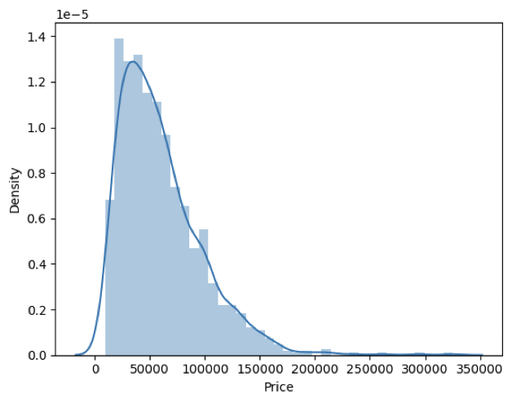
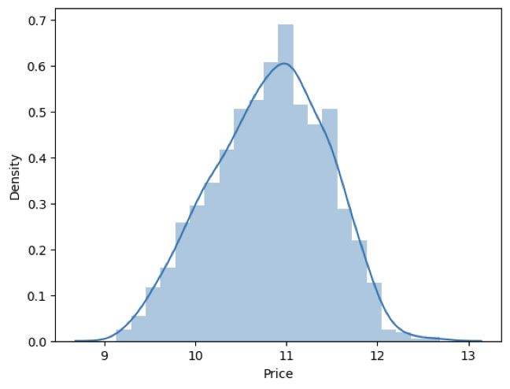
Price is positively skewed (right-skewed distribution)
Price of laptops is a positively skewed distribution.
For predicting the price-points properly, we will be using the log transformation of the price feature, which would convert the right-skewed distribution into a distribution that is more normal / standardized for the sake of better machine-learning

Slide 6
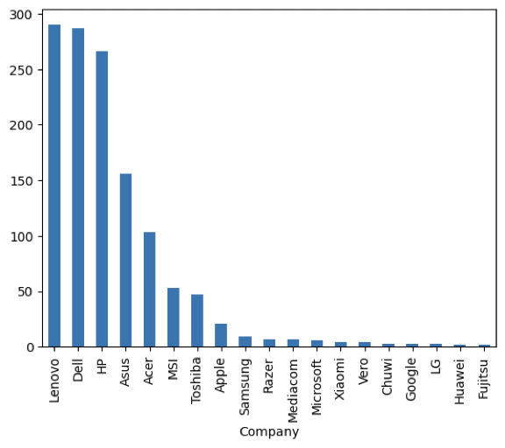
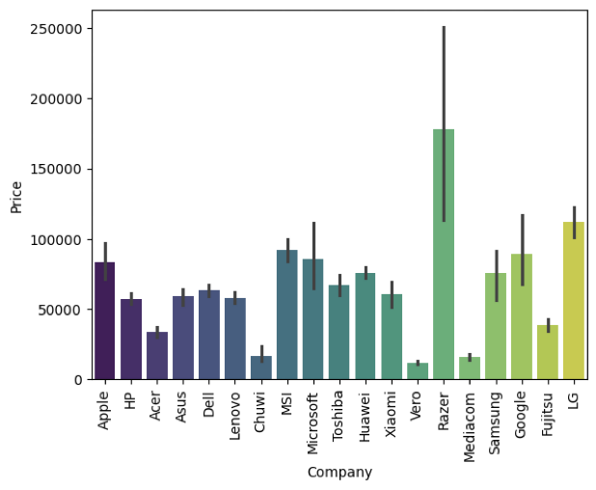
Price varies as the brand of the laptop
Brands like Lenovo, Dell, HP have greater market presence, but are lower priced as they are mass / masstige brands
Brands like Razer, LG, MS, MSI, and Apple have low to moderate presence but are higher priced, on account of their premiumness
Brand therefore influences price points of laptops significantly

Slide 7
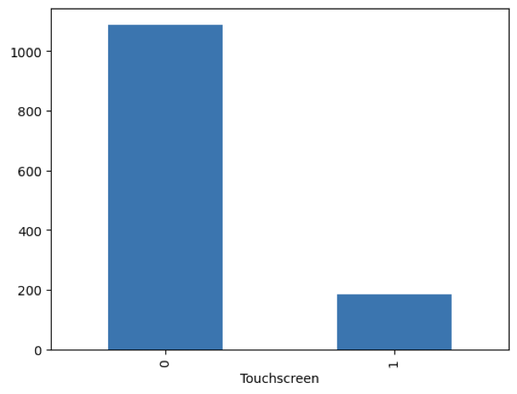
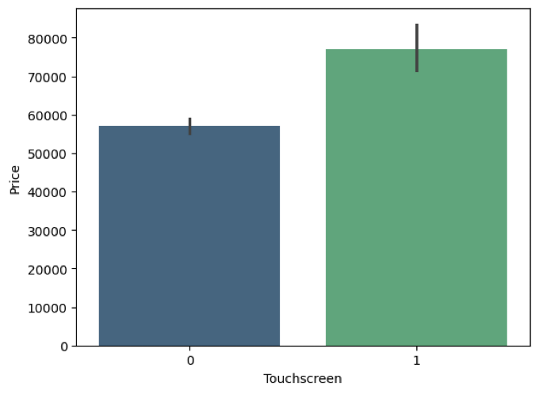
Touchscreen laptops command a higher price than non-touchscreen laptops
Touchscreen laptops are the least stocked laptops; however they command a premium price compared to the non-touchscreen laptops
Price is therefore influenced by whether a laptop has a touchscreen display or not – If it has, it will be higher priced than the model which does not have a touchscreen
ML Case Study, Insights and Recommendations

Slide 8
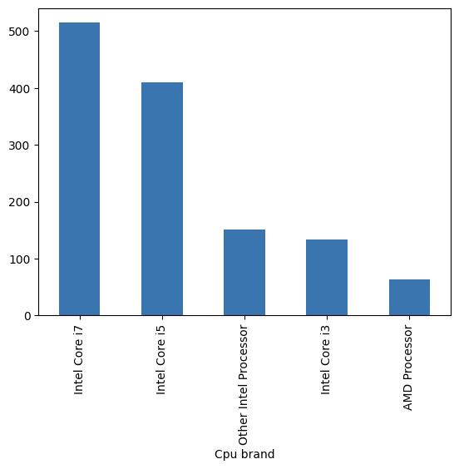
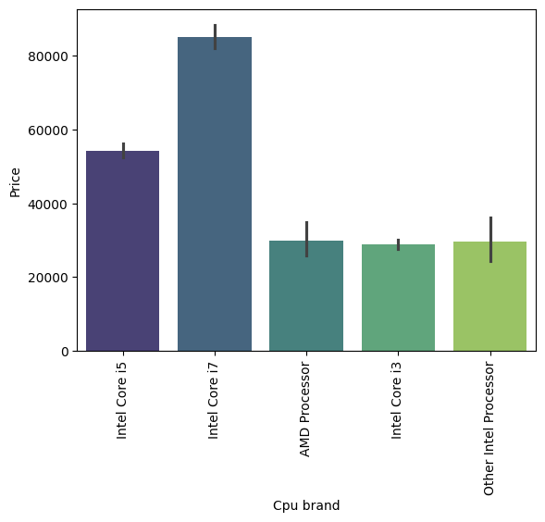
The higher the power of the Processor and its brand, the greater its price
Intel is the dominant CPU (Processor) brand in the market and it commands a premium compared to its competitor AMD.
The higher the power of the processor and if it is an Intel processor, it’s price will increase accordingly.

Slide 9
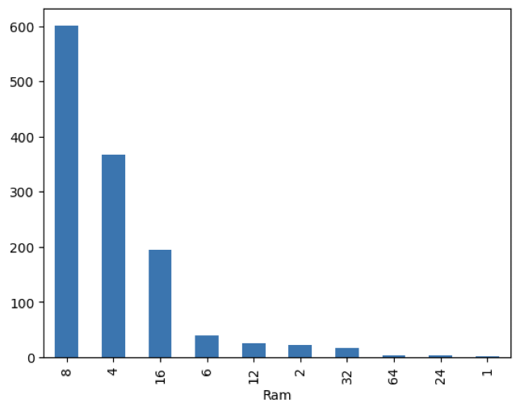
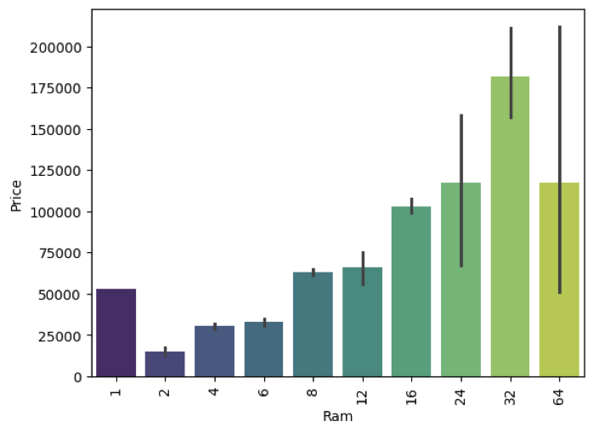
Directionally, higher the RAM, the higher the Price of the device.
While 8GB and 4GB RAMs dominate the market in supply, they are priced moderately and cater to the mass segments of consumers.
16GB, 24GB and 24GB RAMs command a premium, and are lesser in stock in the market as well.
The higher the RAM, the higher the price point of the laptop.

Slide 10
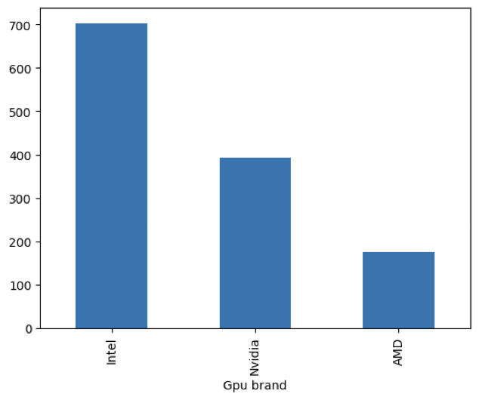
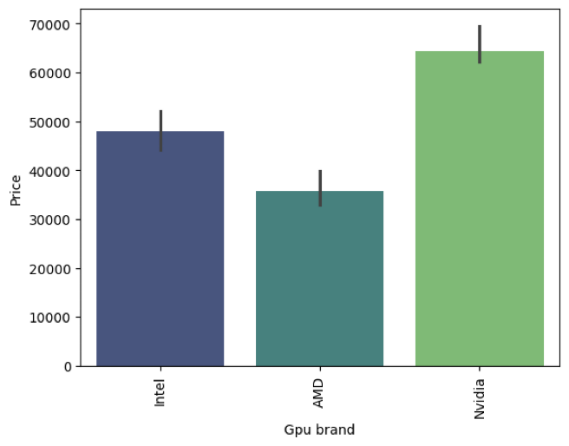
GPU brand impacts the price point of the device
While Nvidia is a moderately dominant brand, it commands a higher price point perhaps on account of better quality
Intel and Nvidia are more dominant in the market and higher priced compared to AMD
This signifies that GPU brand does influence the price of the laptop.

Slide 11
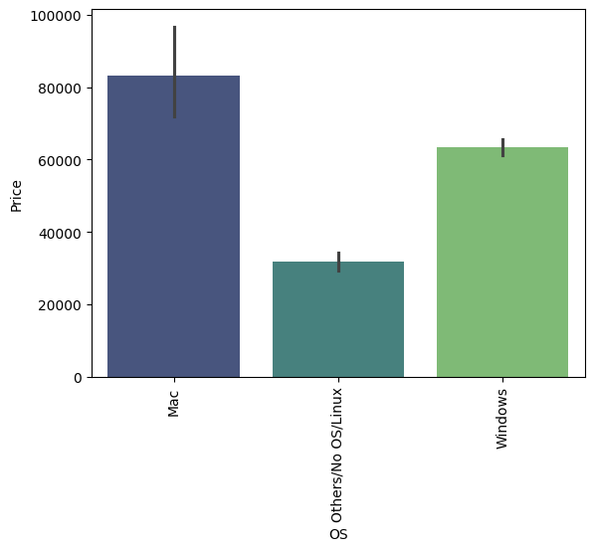
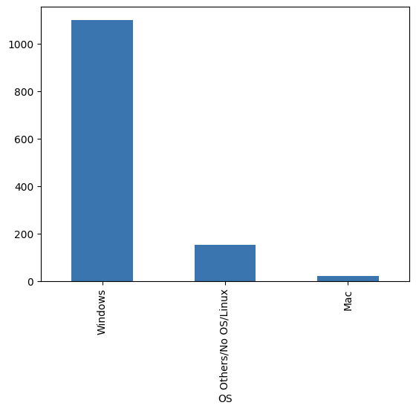
Operating System (OS) impacts the price point of the device
macOS is the highest priced Operating System in the market, followed by Windows. Other OS are not that dominant in the market or as highly priced
Price is influenced by Operating System – a more premium OS will command a higher price.

Slide 12
RAM and SSD are the most positively correlated features with Price
The heatmap shows that RAM and SSD have an above average correlation with Price of the laptop. This means that higher the RAM / SSD, the higher the price of the laptop
Conversely, existence of an HDD in the laptop has the potential to bring down its price – which aligns with the fact that HDDs are getting outdated these days
PPI also has a moderate impact on the price point of the laptop
Existence of IPS and Touchscreen are also positively correlated with the price of the laptop, however to a much lesser degree

Slide 13
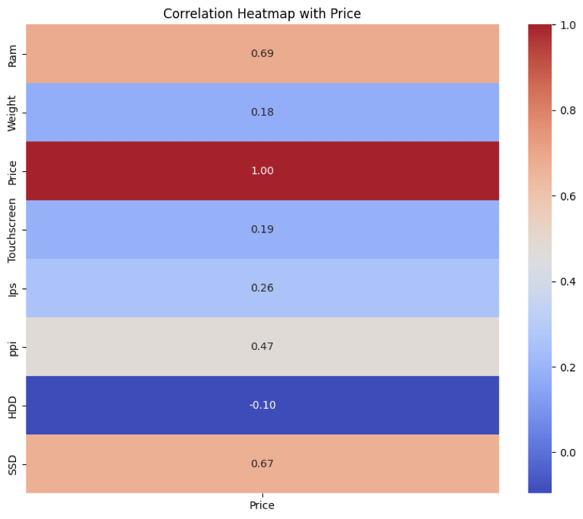
Laptop Price Prediction
ML Case Study, Insights and Recommendations

Slide 14
Selected Model: Random Forest Regressor (R2 Score: 0.88)
We trained and tested the dataset on 5 different models namely:
Linear Lasso Regression
K-Nearest Neighbors (KNN) Regression
Support Vector Machine Regression
Random Forest Regressor
Decision Tree Regressor
Out of these, the best fit model was Random Forest Regressor, with R^2 Score of 88% and RMSE of 0.20
We decided to go ahead with this model since it is neither underfit nor overfitting the data and the predictions are largely accurate across all the tested cases

Slide 15
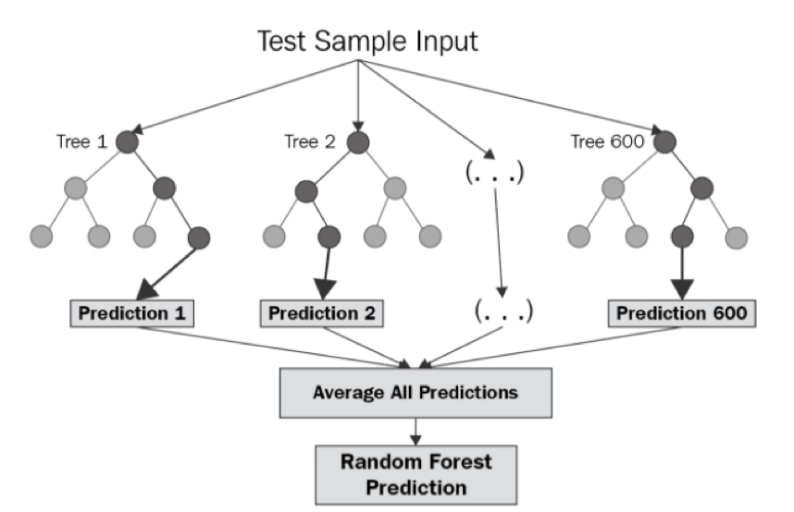
Laptop Price Prediction
ML Case Study, Insights and Recommendations
Illustrative Working of Random Forest Regression Models

Slide 16
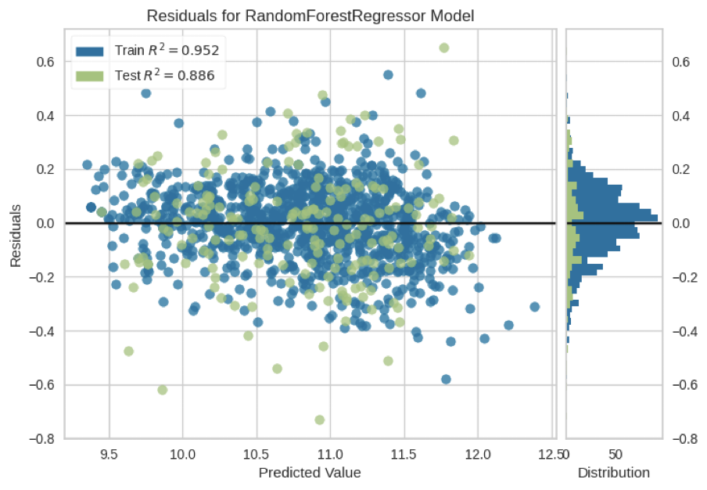
Residuals Analysis
The Residuals Plot for RF Regressor Model depicts the following:
Training Data R2 Score is 95%
Test Data R2 Score is 88%
This shows us that the model is neither overfitting nor underfitting – rather it is the best fit we could get.
The dispersion and distribution of residuals in the chart for train vs. test is also fairly well-distributed, which indicates that the model is able to generalize well for predicting prices of laptops

Slide 17
Price & Demand Estimation Analysis/Market Basket Analysis
Price Estimation:
Given the existing data on general prices in the retail laptop selling market and high-level competition price data, price changes could be estimated which would help forecast future sales trends as well.
Demand Estimation:
With the help of inventory and sales data of the store, future demand trends could be forecasted, which helps in maintaining optimal stock levels of different laptops

Slide 18
Thank You..
ML Case Study, Insights and Recommendations

